Slide 1


Parallel MPI Project

Slide 2
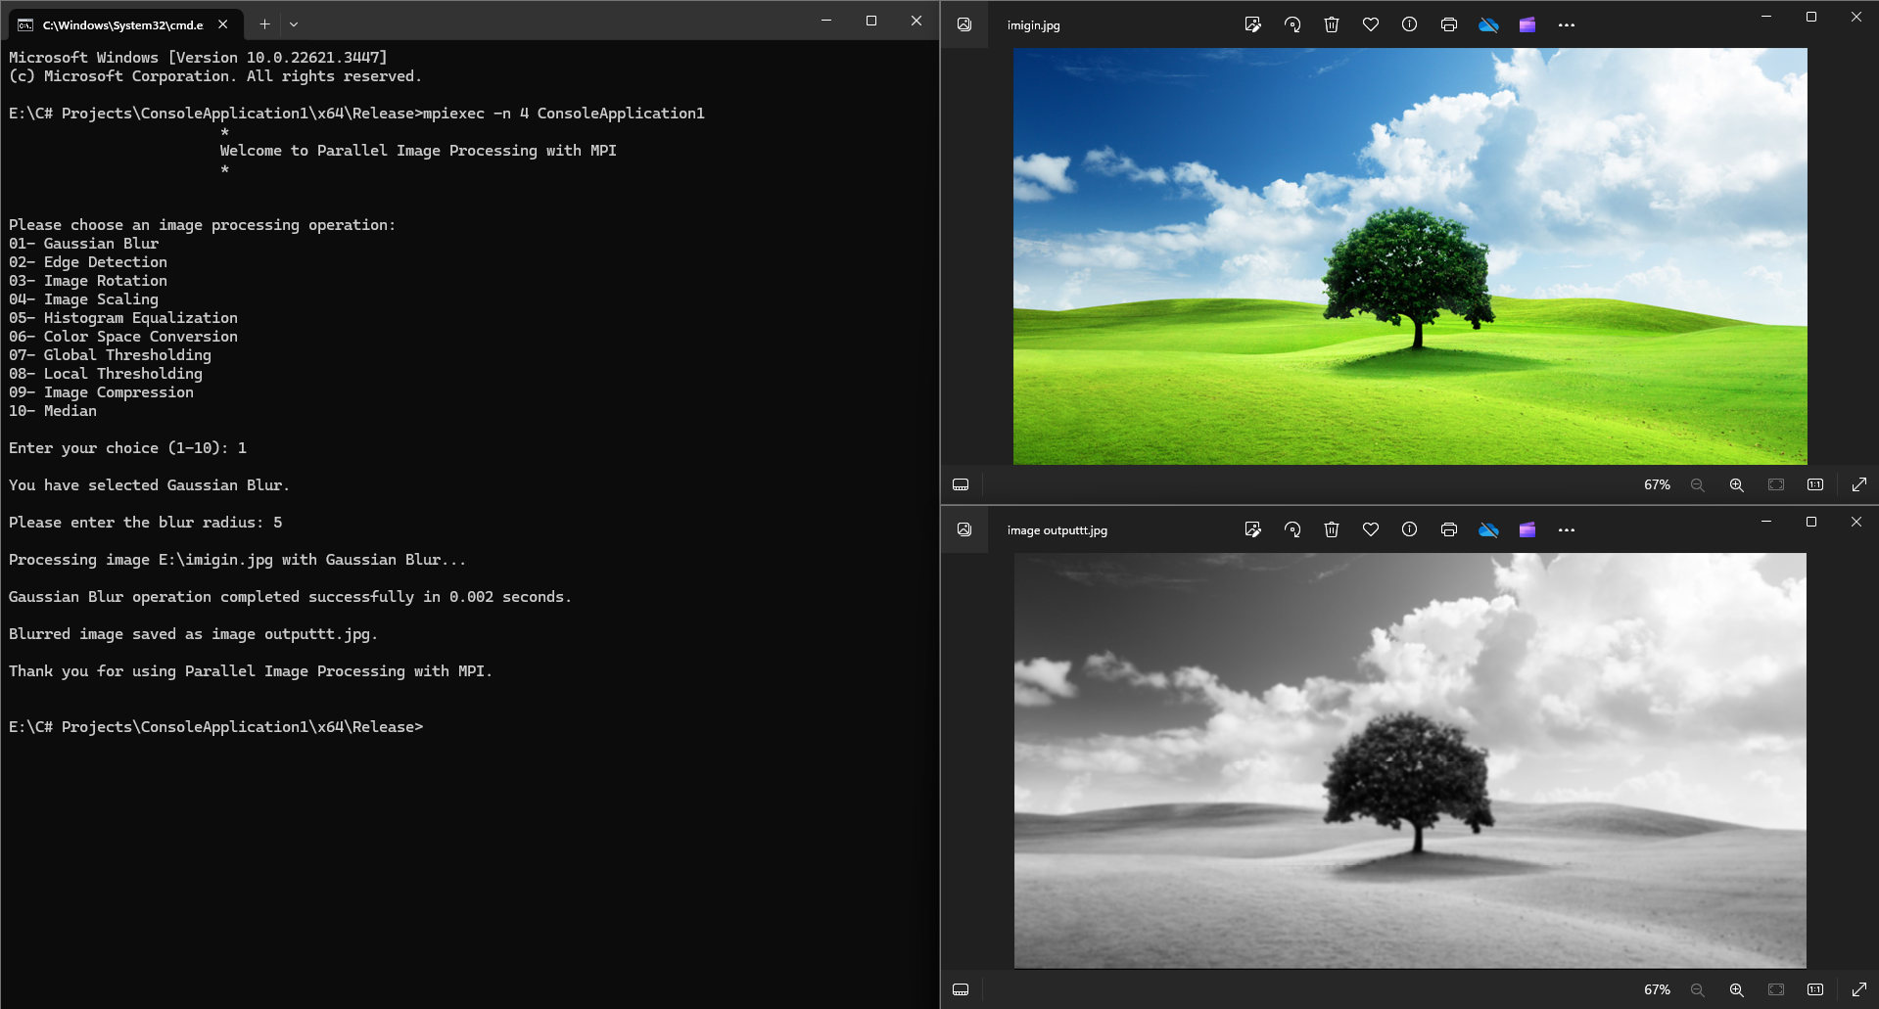
Gaussian Blur :- Filter

Slide 3
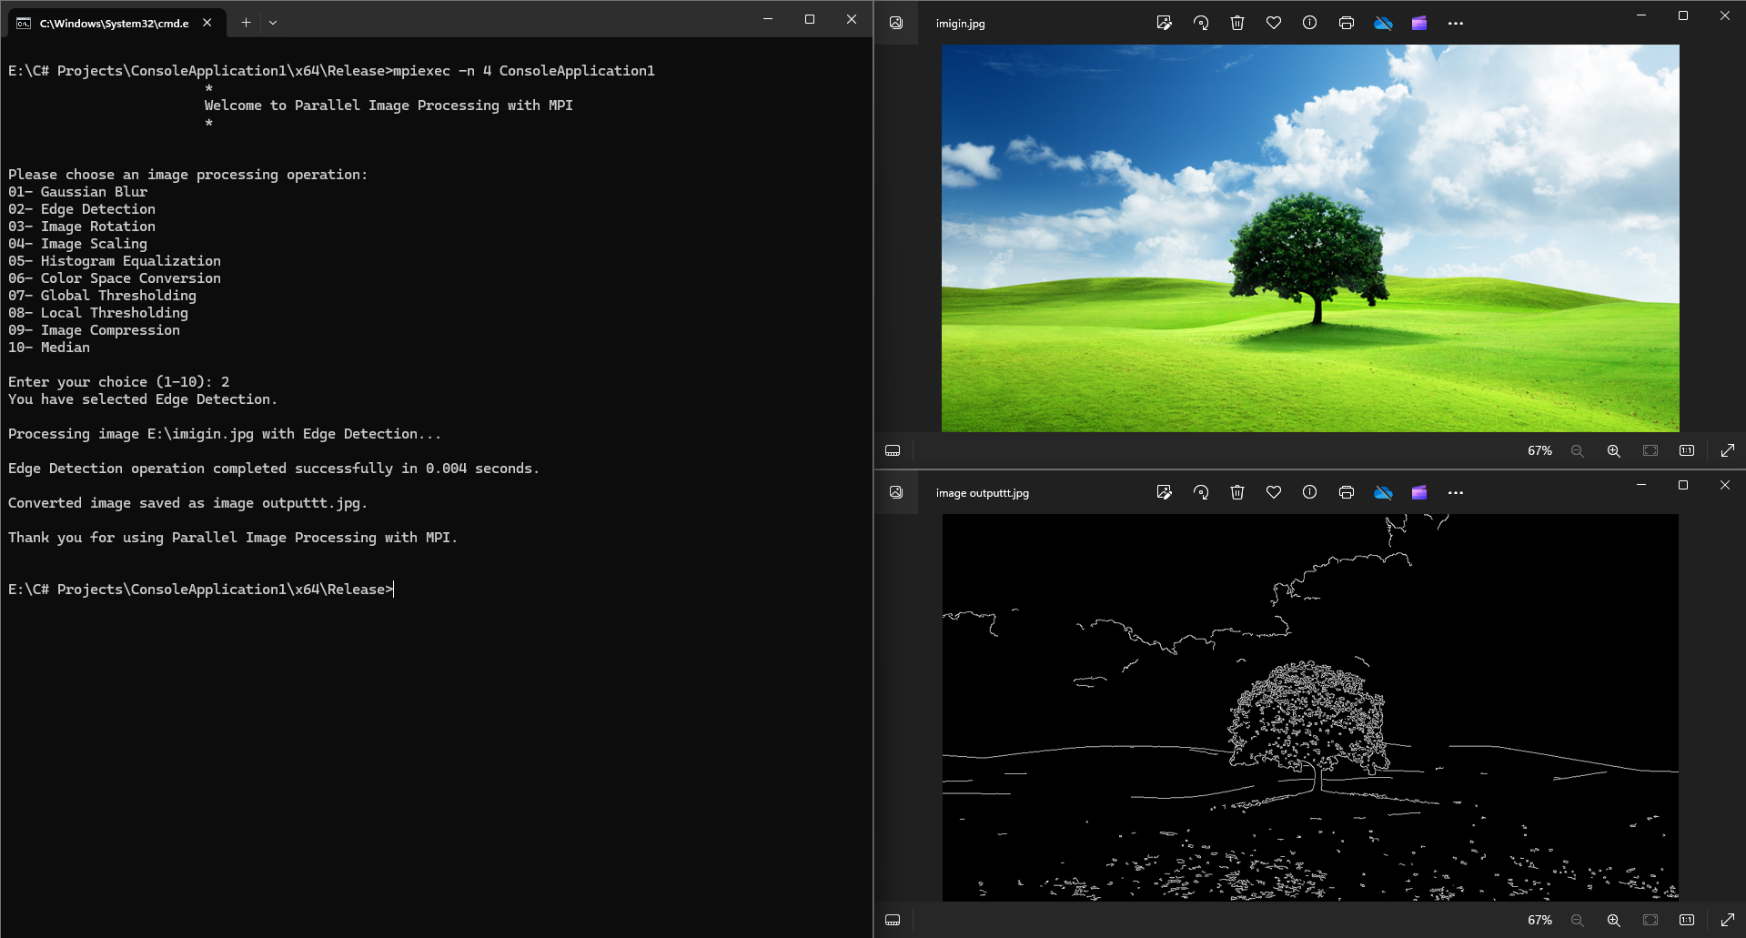
Edge Detection Filter:-

Slide 4
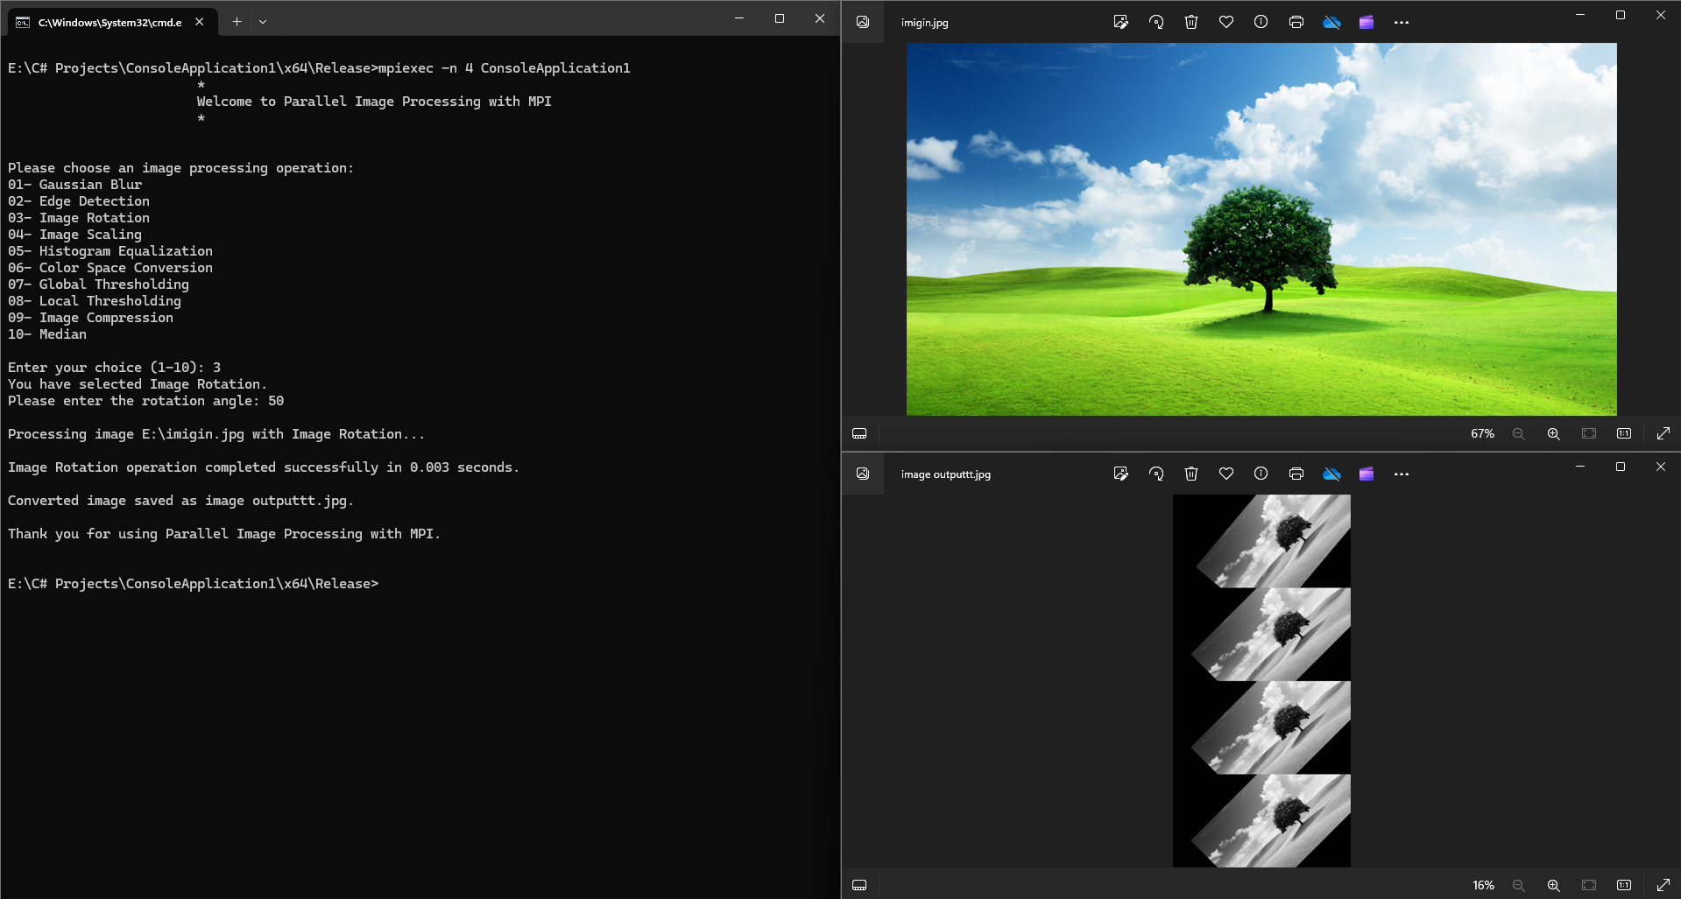
Image Rotation Filter:-

Slide 5
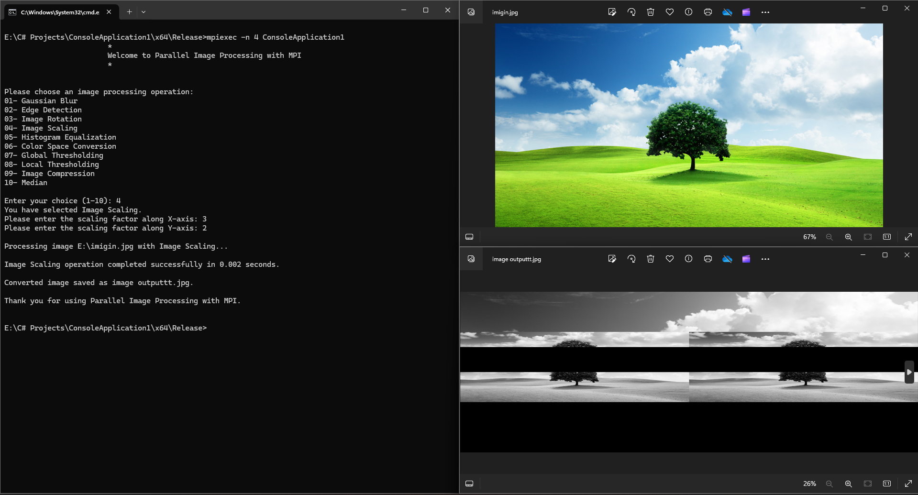
Image Scaling Filter:-

Slide 6
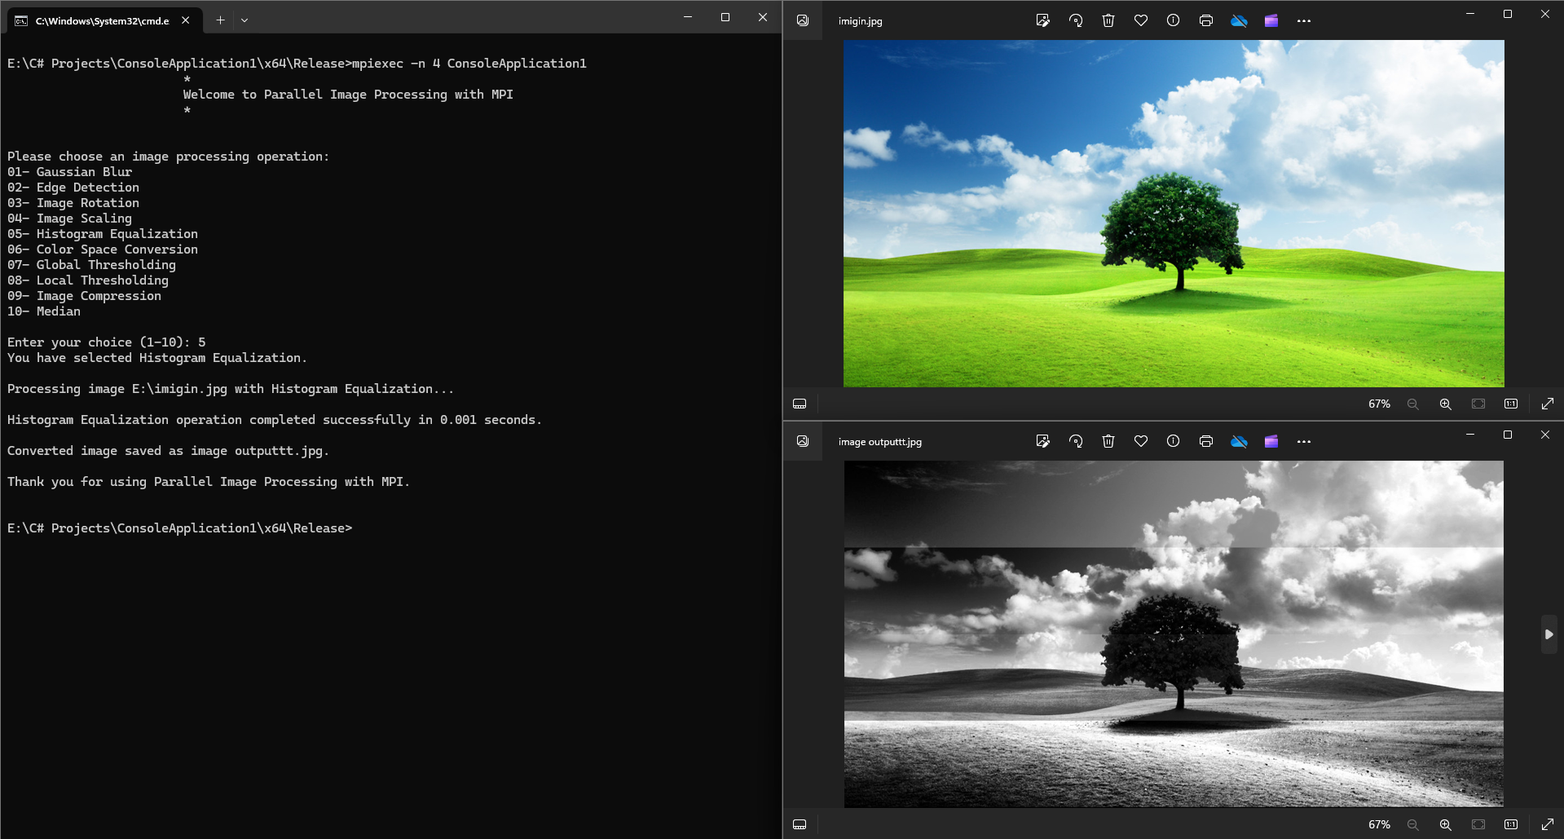
Histogram Equalization Filter:-

Slide 7
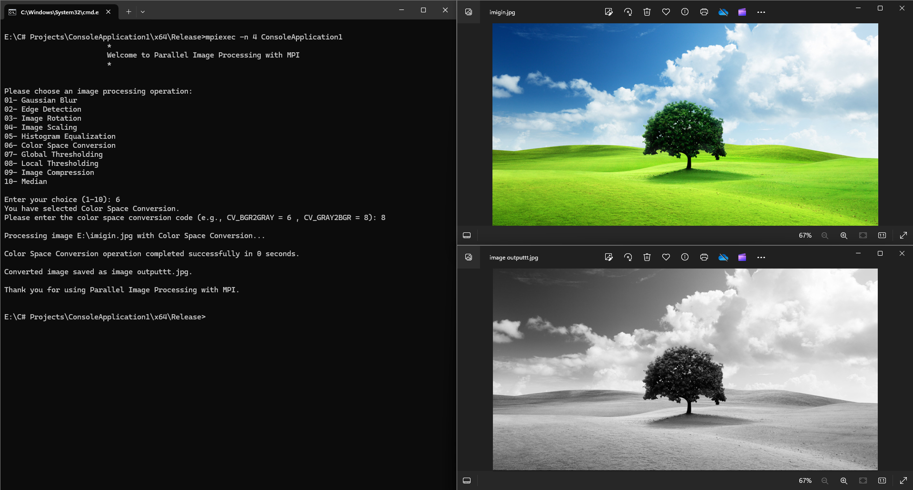
Color Space Conversion Filter:-

Slide 8
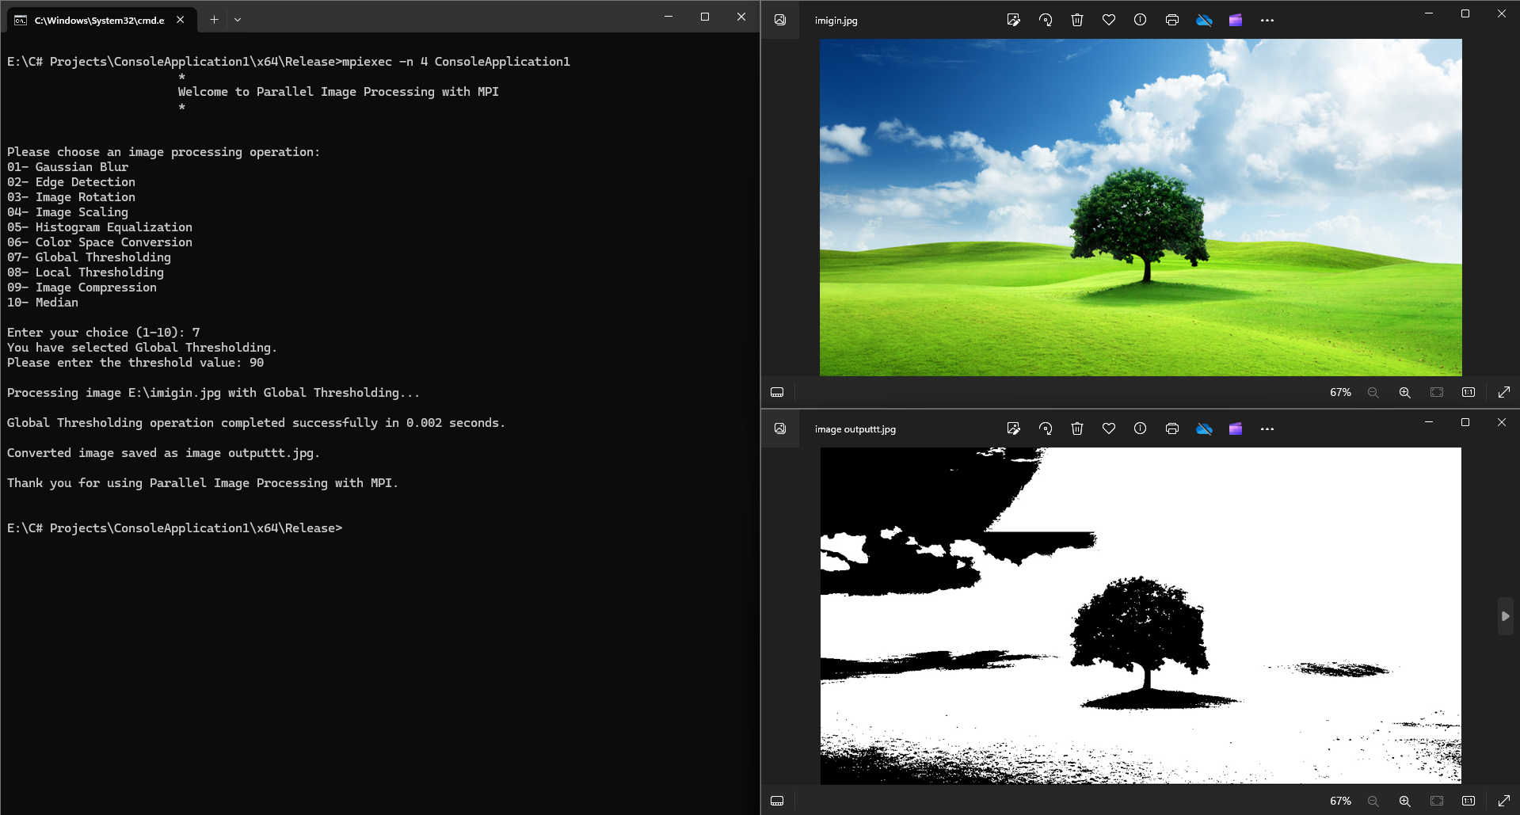
Global Thresholding Filter:-

Slide 9
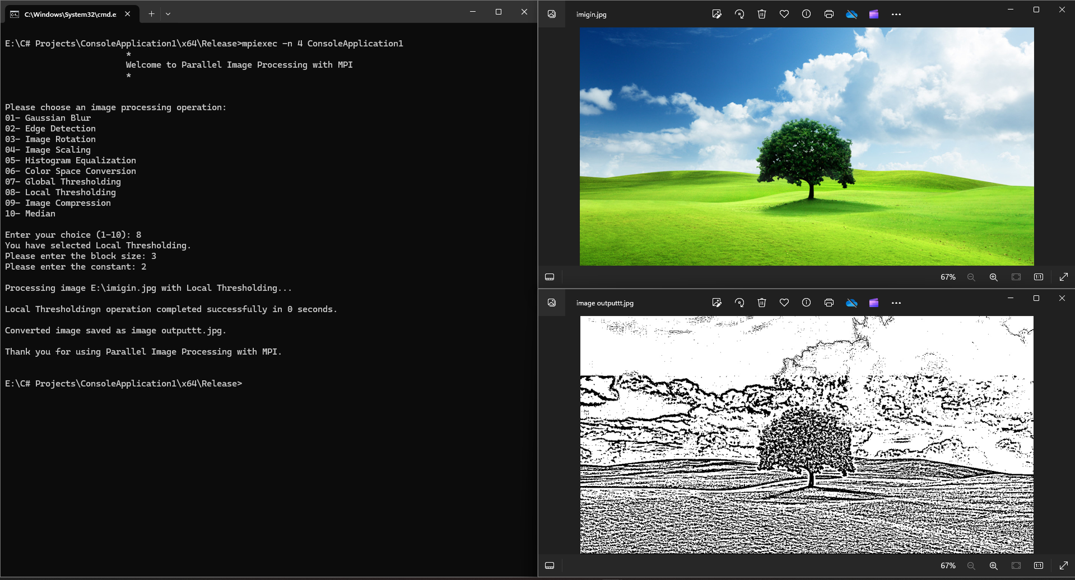
Local Thresholding Filter:-

Slide 10
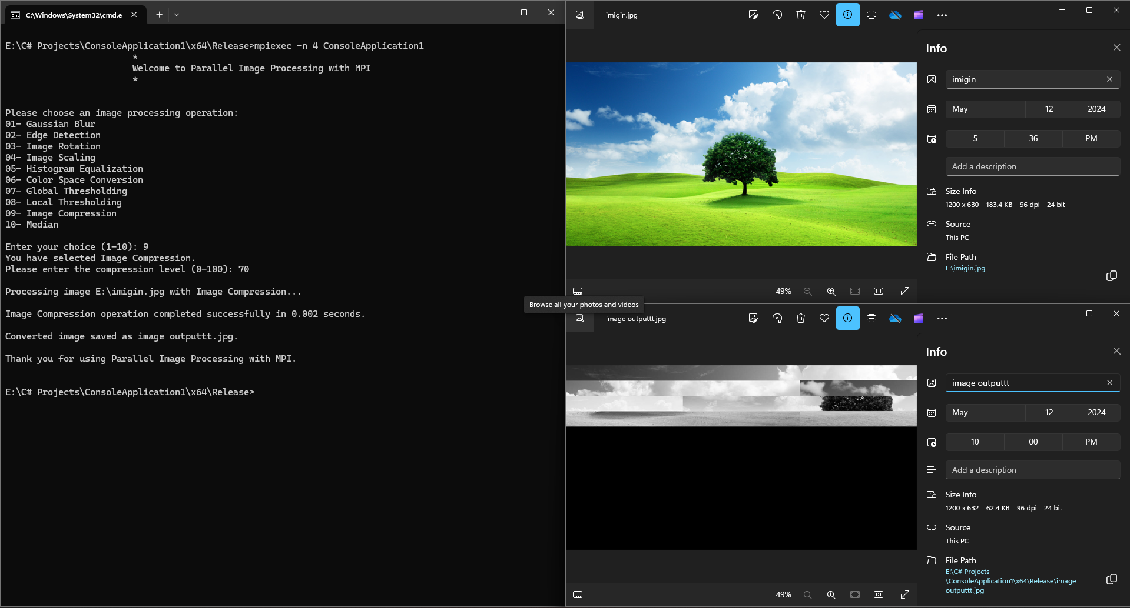
Image Compression Filter:-

Slide 11
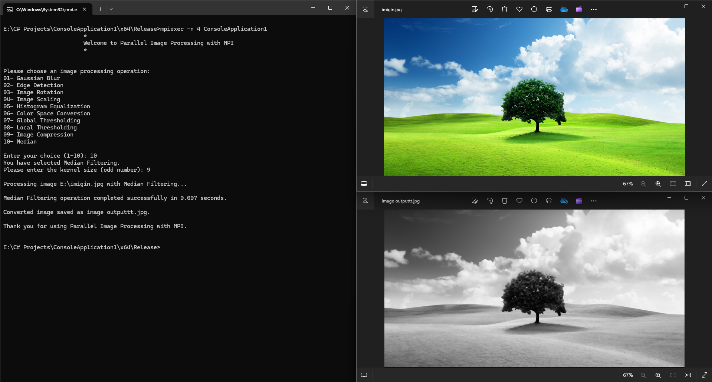
Median Filter:-

